Slide 1
Traffic Flow Simulation: Roundabouts vs. Signals
Internship 2026
Customer Intelligence

Slide 2
Traffic Flow Simulation: Roundabouts vs. Signals
Background
While traffic signals are a norm in controlling urban traffic, sometimes they are ill-suited for regulating the natural flow of traffic. There have been experiments in the past to substitute traffic signals with roundabouts and this has led to better traffic flows which is also self managed and reduced the fatalities related to accidents. While the preference for either is not the scope of this project, the idea is to create the capability to simulate real life traffic flows and experiment with different options

Slide 3
Traffic Flow Simulation: Roundabouts vs. Signals
Objective
The goal of this project is to develop a traffic simulation software that compares the efficiency and effectiveness of roundabouts and traditional traffic signals in managing urban traffic flow. This simulation aims to provide insights into traffic dynamics, safety, and environmental impacts associated with each design.

Slide 4
Traffic Flow Simulation: Roundabouts vs. Signals
Key Features:*
Simulation Environment:
A visual interface to simulate an intersection, allowing users use various combination of roundabouts and traffic signals.
Vehicle Behavior Modeling:
Implementation of basic driving behaviors for different vehicle types, including acceleration, deceleration, and lane changes.
Traffic Management:
Fixed-time traffic signals with customizable cycles and roundabout yielding behavior.
Data Collection and Analysis:
Metrics such as average wait time, number of stops, and congestion levels will be recorded for comparison.
Visual Analytics:
Graphical representation of data to illustrate differences in performance between different traffic management systems.
*Scope can be increased or reduced based on timelines and other factors

Slide 5
Traffic Flow Simulation: Roundabouts vs. Signals
Technologies*
Programming Language:
Python or JavaScript for simulation development.
Visualization Libraries:
Pygame or Three.js for graphics; Matplotlib or D3.js for data representation.
*Technologies listed here are indicative, can be changed as needed

Slide 6
Traffic Flow Simulation: Roundabouts vs. Signals
Additional notes
Successful Implementations
Tucson, Arizona
Tucson has successfully implemented multiple roundabouts, notably the roundabout at the intersection of Campbell Avenue and Grant Road. This installation improved traffic flow and reduced accident rates significantly.
McKinney, Texas
The city of McKinney constructed several roundabouts, including one at the intersection of Virginia Parkway and Ridge Road. These roundabouts led to decreased travel times and improved safety, becoming a model for future developments.
Dover, England
The town of Dover transformed its road network by replacing traffic signals with roundabouts. This initiative resulted in a 40% reduction in accidents and increased traffic efficiency, showcasing the effectiveness of roundabouts in urban planning.

Slide 7
Traffic Flow Simulation: Roundabouts vs. Signals
Variations of roundabouts
The goal is not to determine which of the above options is better but to evaluation different conditions and combinations for optimal traffic flow. Some variations include:
Hybrid Roundabout
Combines elements of roundabouts with other intersection designs, such as traffic signals or pedestrian crossings, to improve safety and efficiency.
Signalized Roundabout
Integrates traffic signals at certain entry points or within the roundabout itself, allowing for controlled flow during peak times.

Slide 8
Proposed Solution
Traffic Flow Simulation: Roundabouts vs. Signals
Customer Intelligence

Slide 9
Traffic Flow Simulation: Roundabouts vs. Signals
Overview
A web-based traffic simulation platform that: Simulates a single urban intersection. Supports: Traffic Signals Roundabouts Hybrid Intersections Allows users to configure traffic conditions. Generates visual simulations and performance analytics. Provides a transparent recommendation system based on user-defined priorities. Goal: Compare solutions, not declare a universal winner.

Slide 10
Traffic Flow Simulation: Roundabouts vs. Signals
Simulation and Traffic Modelling
Traffic Parameters Vehicle arrival rates Number of lanes Signal timing Roundabout radius Available intersection space
Vehicle Behaviour
Acceleration & deceleration
Car-following behaviour
Lane-changing logic
Signal compliance and yielding rules
Output
Realistic traffic movement snapshots
Simulation statistics for analysis

Slide 11
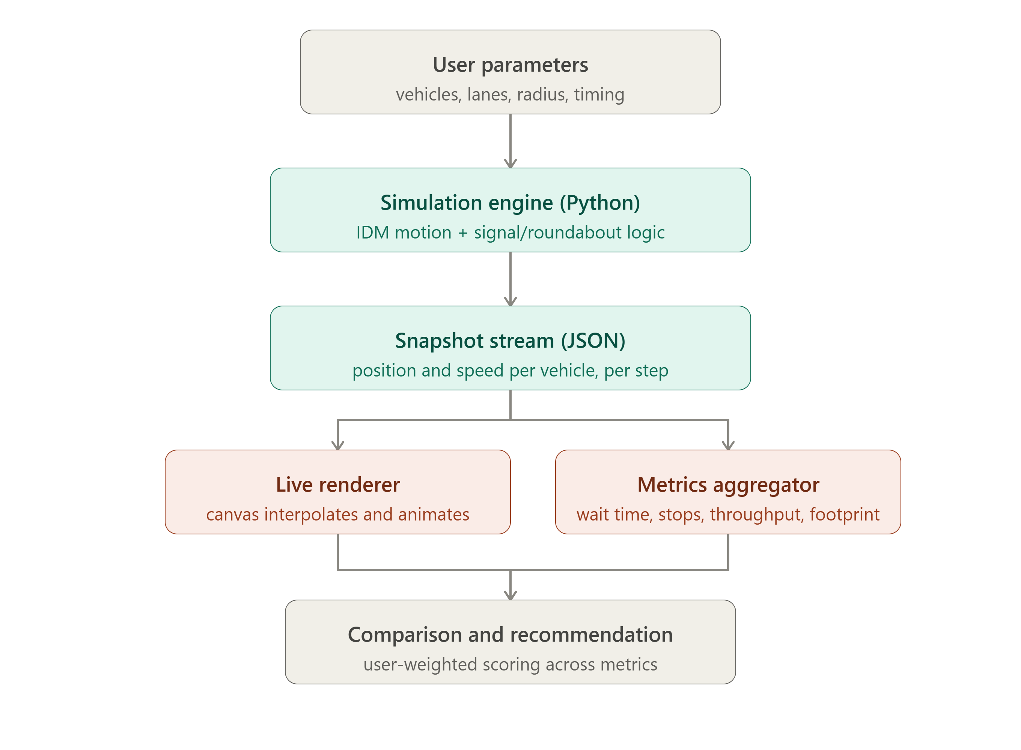
Traffic Flow Simulation: Roundabouts vs. Signals
System Architecture

Slide 12
Traffic Flow Simulation: Roundabouts vs. Signals
TechStack
Component | Technology
Simulation Engine | Python
Backend API | FastAPI
Data Exchange | JSON
Visualization | HTML5 Canvas
Analytics | D3.js / Chart.js
Storage | Local Storage / IndexedDB

Slide 13
Traffic Flow Simulation: Roundabouts vs. Signals
Metrics and Expected Outcome
Evaluation Metrics Average Wait Time Number of Stops Traffic Throughput Space / Land Footprint Congestion Levels Expected Outcome Visual comparison of intersection designs Data-backed performance insights User-weighted recommendations Foundation for future extensions such as multi-intersection networks and advanced traffic scenarios

Slide 14
Traffic Flow Simulation: Roundabouts vs. Signals
POC – v1
Scope Single intersection (North & South approaches) One lane per direction Straight-through vehicle movement Fixed vehicle arrival pattern Signal and Roundabout control logic Metrics collection and JSON snapshot export Outcome Demonstrates realistic traffic behavior using a shared vehicle motion model. Produces measurable differences between control strategies under the same scenario.

Slide 15
Traffic Flow Simulation: Roundabouts vs. Signals
Working

